Slide 1
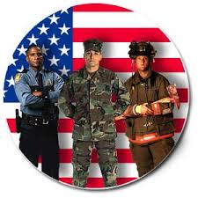
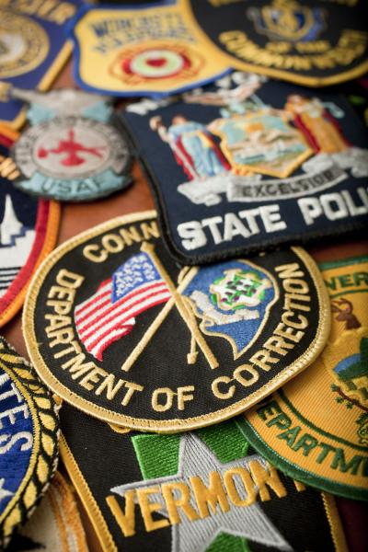
Public Safety services
Sullivan County BOCES

Slide 2
Course Syllabus
Sullivan County BOCES Career and Technical Education
22 St. John Street
Monticello N.Y. 12701
(845) 295-4814
Course Name: Public Safety Teacher: James Noble
Map # Unit Name Hours___
#1 Orientation 5 hours
#2 History of Law Enforcement 5 hours
#3 Police Concepts & Skills 365 hours
#4 Court Systems 125 hours
#5 Corrections Concepts & Skills 125 hours
#6 Security Operations 100 hours
#7 Health Issues 80 hours
#8 Defensive Tactics/ Physical Fitness 80 hours
#9 Career Preparation 15 hours
-------------
900 hours

Slide 3
Police Concepts & Skills
Patrol Operations- (220 hours) Investigations- (145 hours)
1. Station Operations 12. Crime Scene Basics
2. Communications 13. Photography
3. Ethics 14. Crime Scene Sketch
4. Report Writing 15. Evidence Collection
5. DWI 16. Interview/Interrogation
6. Accident Investigation 17. Fingerprinting
7. Domestic Violence 18. Physical Evidence/DNA
8. Narcotics 19. Labs-Bone/Blood Splatter
9. Penal Law, CPL, VTL
10-.Culpable mentality
11. Social media/Cyber Crimes

Slide 4
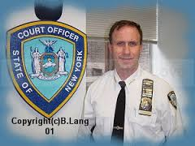
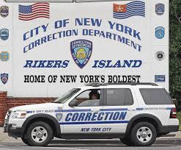
Court Systems- (125 hours)
Structure
Responsibilities
Personnel
Demeanor
Corrections Concepts and Skills- (125 hours)
Structure (Jails v. Prisons)
Personnel (Prison Life)
Juvenile Justice
Gangs
Intelligence
Probation/ Parole

Slide 5
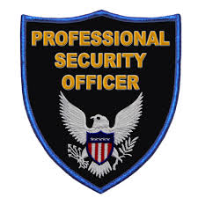
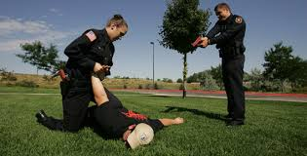
Security Operations- (100 hrs)
Private Security (certification)
Domestic Security
International Security
Health Issues- (80 hrs)
Nutrition
Wellness
CPR/First Aid
Defensive Tactics/ Phys. Ed- (80 hrs)
Ground Survival
Personal weapons
Tactical baton
Fitness Training Programs

Slide 6
Some guest speakers that shared career opportunities and experiences at SC BOCES
Sgt. Dennis Barnett- Montgomery PD- SWAT Team, Accident Reconstructionist, Breathalyzer Operator/ Former Secret Service Agent.
Mat Nolan- FDNY- firefighter/ EMT
Sgt. Roxanne Lopez- Spring Valley PD & United States Marshalls Task Force (Manhunters - Spike TV.)
C.O. Aaron Concepcion and Jodi Michel- Rockland County Sheriff’s Office/ Rockland County Intelligence Officer. Gang Specialist.
Ret. Sr. Investigator Terry Mullen- NYSP - Crime Scene and Accident Reconstruction. Currently Sullivan County District Attorney’s Office Investigator.
SA James Hughes- F.B.I (Former NYPD) Assigned to Miami Office Bank Robbery Division.
Chris Waters- Senior ADA Rockland County DA’s Office- Mock grand Jury
Det. Ted Hughes- Spring Valley PD- Human Trafficking
Trooper Jason Cole- Canine handler
Lt Paul Pratti- Emergency response Team

Slide 7
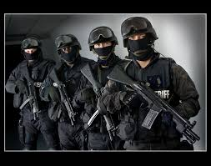
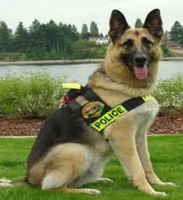
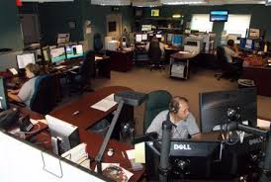
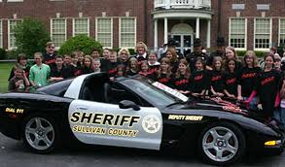
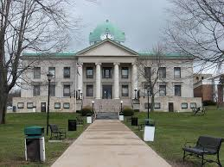
Field trips to WTC Museum, Orange County Police Academy.
Tours of Public Safety Complex, Jails, 911 center, Fire Safety Centers, County Court House
Demonstrations by SWAT and Canine

Slide 8
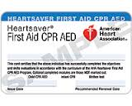
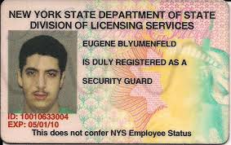
Programs Benefits
Post-Secondary Articulations:
Sullivan County Community College
Herkimer County Community College
Columbia-Greene County Community College
Bryant & Stratton College
Mohawk Valley Community College
Monroe College
Industry Certifications:
8/16 Hour Security Guard Certification
American Heart Association CPR/AED

Slide 9
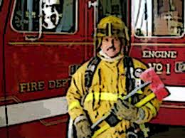
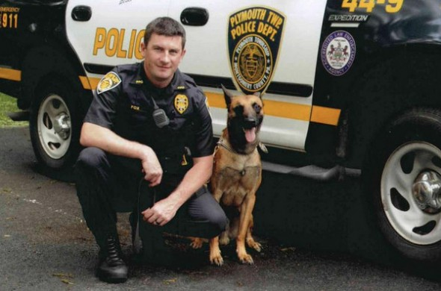
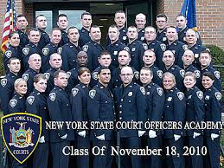
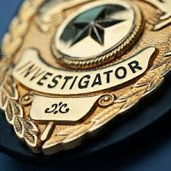
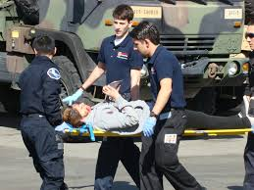
Career Opportunities: Additional post-secondary education is required for the majority of these careers:
Security/Patrol/Courts/Corrections
Investigations
Military Police
Forensics-Crime Scene Technician
Emergency Dispatcher
Loss prevention
EMS/Fire
Intelligence Analyst

